Slide 1

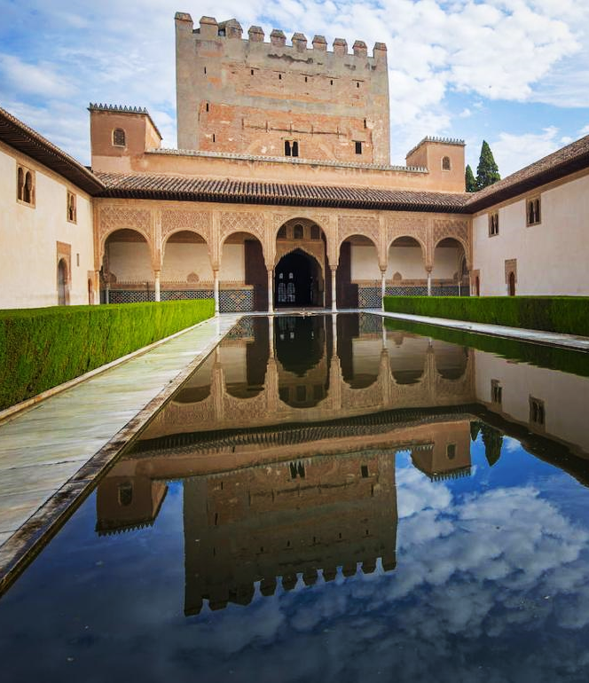



Erasmus+ n. 2021-1-IT02-KA220-SCH-000032800
EDULARP
Film and Water

Slide 2
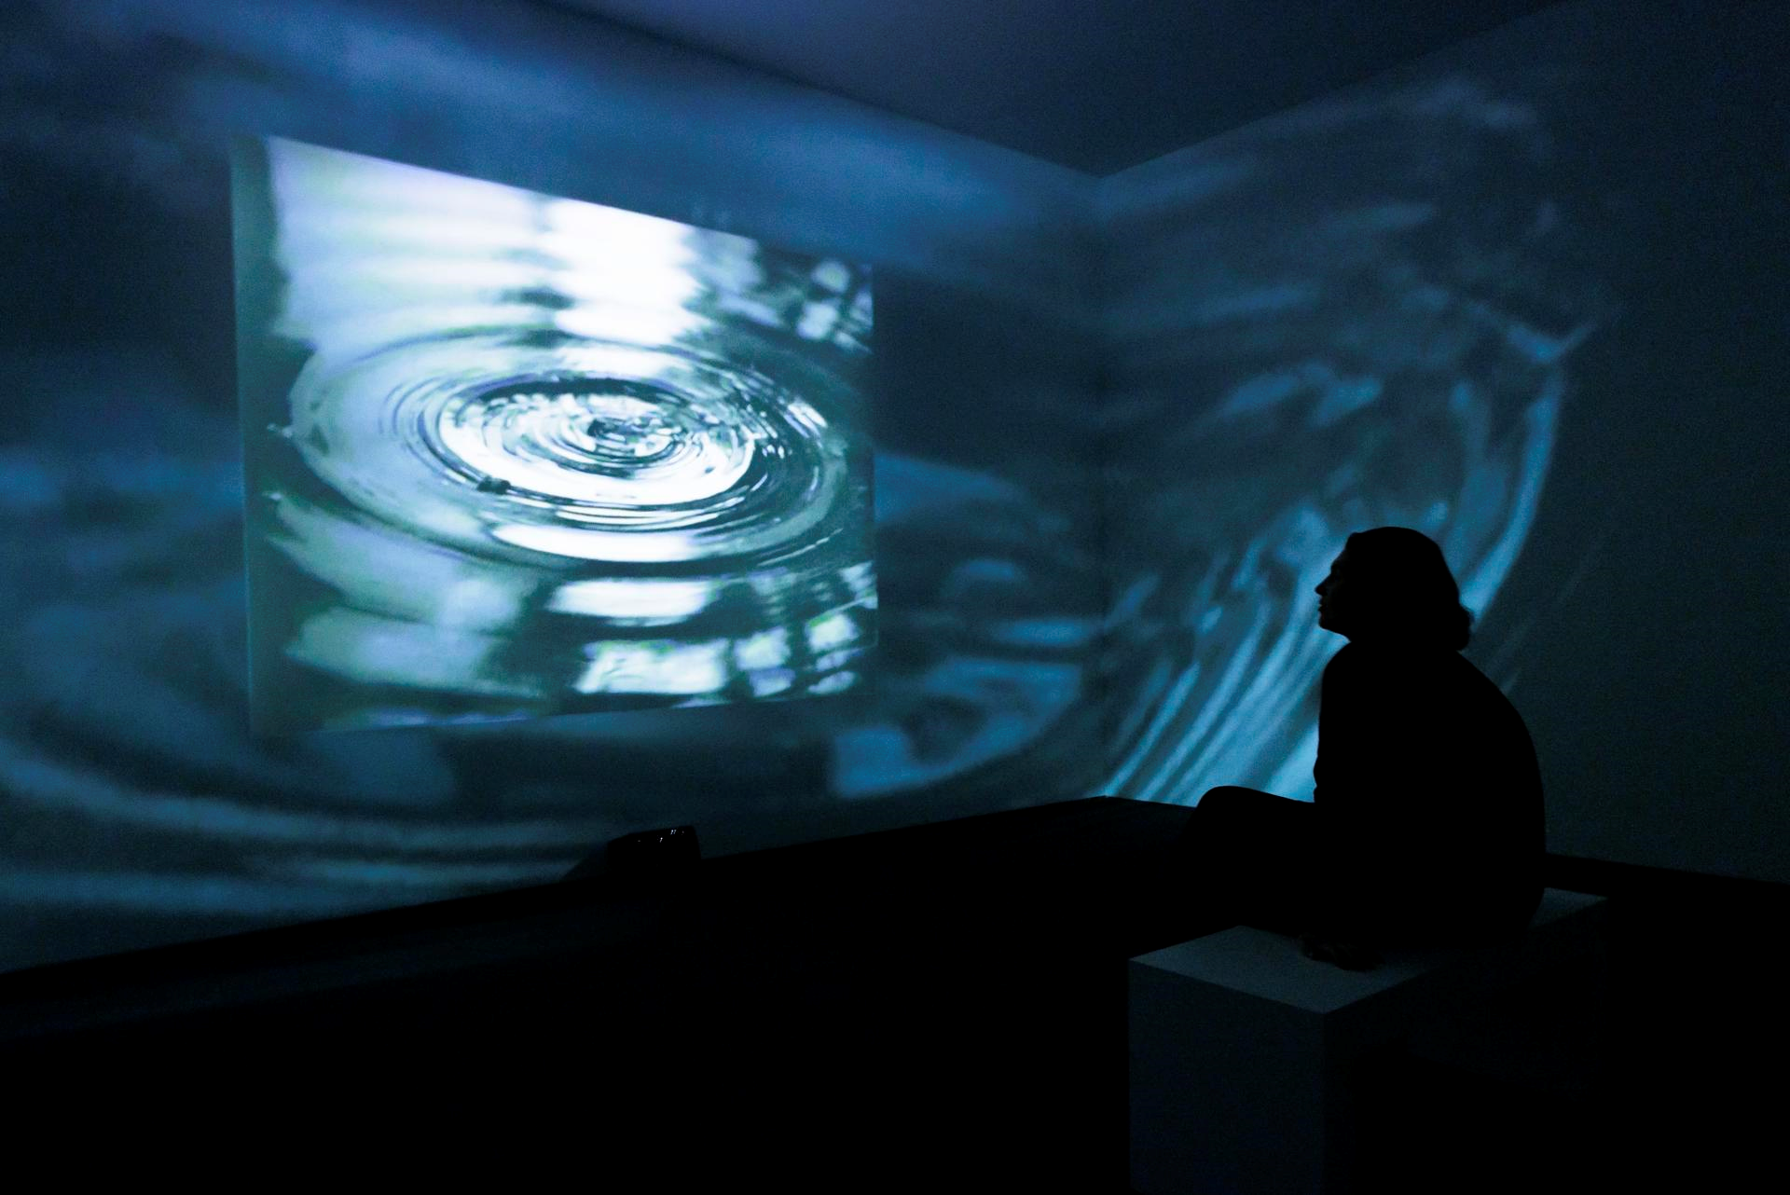
FOCUS ON EDULARP:
NARRATIVE FRAMEWORK
The climate change has vast consequences on the environment. One of those directly affects the countries of southern Europe. The desertification of these areas of de continent is able to be seen nowadays, and this particular issue has an special victim, the water. The water is a precious gift that we have to protect. The European Union is pretty worried about this issue, so, the highest institution in the continent pressure the Goberment of a country of the south of Europe to develop a effective campaign which raise awareness about water use. The European Union is very worried also not because the waste of water, but this country is the biggest vegetable garden in the continent, and is vital maintain the ecosystem because Europe needs this food. So, «We» work in film industry, in a film company. The government has commissioned us to make a spot or commercial about the importance of not wasting water. A good film capable to make aware of the importance of water. So, get on with it! This is our important mission, The scarcity of water is alarming. We must make aware population of this country how important is water, because this scarcity will affect all of us. Granada is a city with a very important Arab legacy. We want to focus the production of the audiovisual piece on the transcendental use of water that the Arabs made: fountains, aljibes (drinking water cistern made by the Arabs), acequias (ditches)

Slide 3
FOCUS ON EDULARP:
PLOT
Of course we won’t make a film, the Edularp involves making a brief shot about scarcity of water this is the main objetive of the game. During two days of work, students will learn how to write a script based in a one idea, previously chosen and film a brief shot based in this idea. FIRST DAY: the have to chose a plausible idea to be made in the film set of Curva Polar and the resources we have. Once the idea has been chosen. The students will divided in four departments: Direction, production, Camera Crew and Art direction. The students will begin filming their audiovisual pieces and will start recording their audiovisual pieces starting with the use of set resources and combining it with exteriors SECOND DAY: Students will visit the Alhambra and other places related to the sustainable use of water carried out by the ArabsEach of them must perform his/her role, that is, the director role, the assistant director role, the photography director role, etc, and so on. THIRD DAY: It is the day in which the assembly and post-production of the audiovisual pieces will be carried out. Finally, the final works will be projected.

Slide 4
FOCUS ON EDULARP:
MAIN CHARACTERS
The DIRECTOR: Is the person who has a vision of how things must be made. Smart, a little bit strict but with common sense, he/she is capable to recognize he/she make mistakes. Analyze the proposed script for the film and transform it into a technical script. For these purposes, the director must plan the shooting of the sequences, determining the movements of the camera, types of lenses, etc. In fact, on some occasions, the director himself is also the scriptwriter . Participate in the choice and search for locations, guide the style in terms of costumes, art and decorations, etc. He usually supervises the selection of actors and actresses in the casting, as well as directing the pre-shooting rehearsals. During the shooting, you must coordinate all the teams involved in the production. Among other issues, you must ensure that the shooting schedule is followed and that resources are used efficiently (in coordination with the production team). One of the most important tasks of the director is to supervise the location and the movements of the camera and to direct the actors during the shooting. In this sense, you have the last word to decide when a sequence is successful or if it should be repeated. Supervise the editing of the film and make the corresponding decisions during this process, in coordination with the editor or editor. Likewise, you can participate in everything related to visual effects and sound design, including the incorporation of the soundtrack.

Slide 5
FOCUS ON EDULARP:
MAIN CHARACTERS
The PRODUCER: He/She is the responsible of the project, if things go wrong, he/she has to made up a solution. Also He/She is the person who mansges the money. The production manager is in charge of organizing all the audiovisual material necessary to carry out any type of filming. It is also in charge of organizing and administrative tasks, as well as the plan to be followed by the team workers. For the job to go ahead successfully, he/she has to be in tune with the film director: he/she needs to know the director's ideas in order to be able to translate them. He/She is strict, and doesn’t negociate things. Managing the hiring of personnel: again money management intervenes. On this occasion, to define the workers who will participate in the audiovisual project. Coordinate the artistic creation part: the producer will have the last word after listening to the creative proposal of the different departments. Making decisions that affect the execution of the film with direct. Supervise all technical personnel and determine the treatment, scope and production schedule. Supervise the placement of stages and lighting elements.

Slide 6
FOCUS ON EDULARP:
MAIN CHARACTERS
The DIRECTOR OF PHOTOGRAPHY (DOP): He/she is creative and unstable, doesn’t like to negociate and he/she thinks that is a genius. Coordinate with the Director: the cinematographer must understand the scope of the entire video production and be able to determine what types of equipment will be required. They must have a great understanding of lighting needs and be able to work well with the Director to establish his creative vision for the production. The cinematographer must be highly organized and able to lead a team of photographers during a video production. Your job is to be in control of capturing the scene in front of you using the right equipment and meeting the director's stylistic requirements. As a leader, you must also know how to use all the equipment used during production and be able to instruct others if necessary. As the leader of the visual team shooting the production, the cinematographer will call the makeup or wardrobe department if necessary to make sure everyone in the video looks the part. The job requires the ability to pay close attention to detail and know how to fix any visual issues that arise.

Slide 7
FOCUS ON EDULARP:
MAIN CHARACTERS
The DIRECTOR OF ART: He/she is eccentric and bizarre, unstable and voluble. Strong mood swings. It is in charge of determining and building the style or general visual aspect that is intended to be mounted for each project. He supervises the work of other designers, creatives, and artists creating content for television, film, social media, live shows, advertising, and even the gaming industry. Determine the best way to represent a concept visually. Supervise design staff. Determine what photographs, artwork, and other design elements will be used. Create and develop the visual aspect of an advertising campaign. Develop the look or style of a theater, television, or film set. Review and approve designs, artwork, photos, and graphics. Talking with clients to develop an artistic approach and style. Coordinate activities with other artistic or creative departments. Prepare budgets and detailed deadlines for the assembly of the sets and their accessories. Present designs to clients for approval

Slide 8
FOCUS ON EDULARP:
MAIN CHARACTERS
The GAFFER: The gaffer is in charge of executing and coordinating the lighting of the scenes and the different scenarios, during the production of audiovisual content for film or television. Execute the lighting plan defined according to the indications of the director of photography, with whom he works very closely, to ensure that the registered product has the desired atmosphere and appearance. The gaffer has the electrical and lighting technical teams that work under his orders, creating and controlling the light before and during filming. These teams are in charge of the operational and practical development, that is, the placement, connection and configuration of the technical lighting elements (spotlights, reflectors, filters, projectors, etc.) to create the appropriate lighting for the different scenes to be recorded. Prepares the planning of the human and material resources that will be necessary, detailing the different professional profiles and required skills and listing the technical equipment necessary to achieve the proposed artistic vision. As the person responsible for deciding the light effects and electrical requirements of a film scene, the gaffer must have the artistic vision to know and manage light and the technical knowledge of the necessary equipment to achieve any type of lighting. or effect.

Slide 9
FOCUS ON EDULARP:
MAIN CHARACTERS
The SOUND TECHNICIAN: Is responsible for the technical and artistic quality of the sound obtained in the filming of a film. His team is usually made up of one or more microphones. The main task of this professional is to decide with which microphones each scene is going to be recorded, according to the needs of each one. the sound technician manages the mixing desks, recording equipment, sound reinforcement and music players. During the film shooting, they are in charge of controlling the sound, the output volume of each microphone and maintaining optimal sound quality. When a location is considered finished, the sound technician usually asks for a minute of silence to record an ambient sound from that location, so that this ambient sound can be used for the final mix. At the end of the day, the corresponding sound part will be delivered to the producer where the name of the sound recordings will be correctly specified in relation to the technical script, detailing the technical characteristics of the recording and incorporating the necessary annotations that serve the editor.

Slide 10



