Slide 1



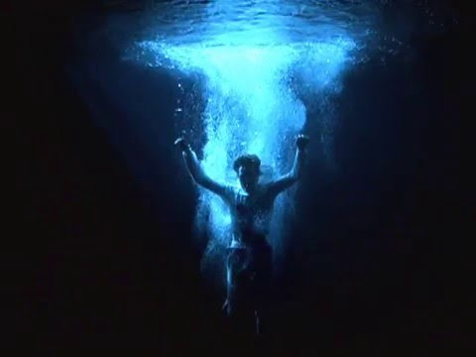

EDULARP
Film and Water
Erasmus+ n. 2021-1-IT02-KA220-SCH-000032800
ARTISTIC CONCEPT

Slide 2
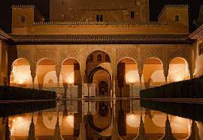
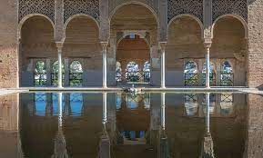
ART. WATER. HUMAN
Water since ancient times has represented the subsistence of life and eternal youth. In Granada, water is linked to Muslim history and culture or, what is the same, to the very DNA of the city. Water, in addition to being a source of life, calm and health, turned into a mirror capable of reflecting and multiplying the decoration in the Muslim Granada Las Vegas. United to the light, incremental the dynamism of its urban center and original incomparable mystical compositions.

Slide 3
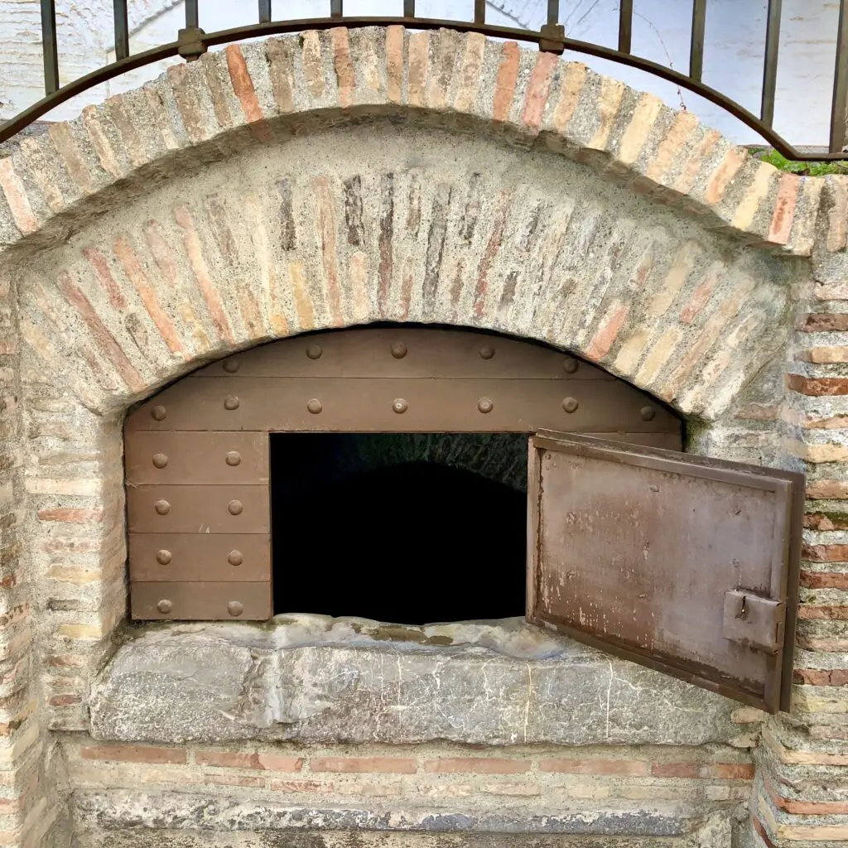
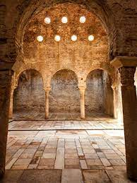
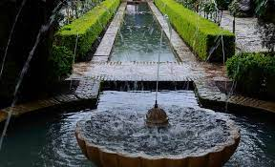
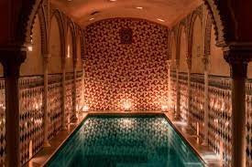
"God spread the waters over the earth so that people could be purified. The bathroom is healthy and delicious. Whoever wants to have a clean soul must have a clean body. The outer spots are a sign of the inner ones. God wants purification and cleansing, etc.”
Let's look at the time of creating in the most important structures on the water: ALJIBE: Built during the Arab domination of Granada, these structures were used to store and supply water to the city. Without these cisterns the settlement of the population on the hill would not have been possible FUENTE/ALBERCA/PILAR: all the water was used and pampered like a treasure. In fact, it was not enough for the Nazaríes to build fountains in the courtyards and gardens, but they also moved the water inside the main rooms, through gutters through which water ran whispering and calm. BAÑO:meeting places of the whole society.In addition to being the center of social relationships, they were used for rest or relaxation and also covered religious needs when performing purification rituals

Slide 4
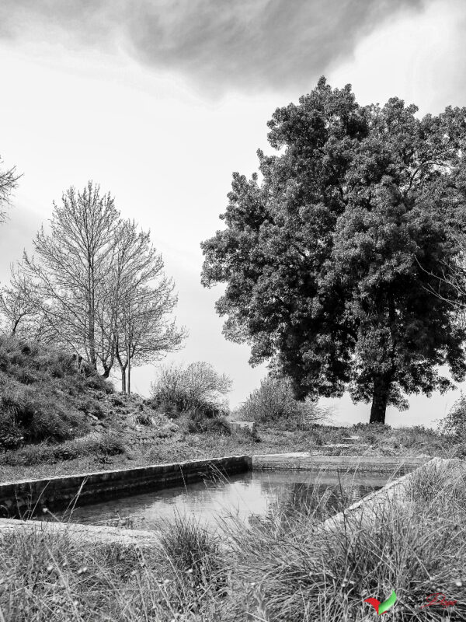
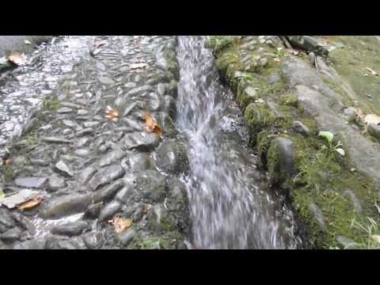
sound The water of Granada was able to captivate illustrious poets, such as Federico García Lorca, Azorín or Juan Ramón Jiménez, who dedicated their best verses to the city and its “hidden water that cries”, as Manuel Machado defined it. Although less and less... the sound of Granada has always been the sound of water. Sound Cartography is the term we use to define and
*Words.
HOW do you speak?
*Emotional.
The sound of your voice according to your emotion.What are you saying and how do you say itWhat do you want to convey and the reflection that comes with wanting to be heard.the sound we make when we talk should be as flexible as the possibilities of the shape of water

Slide 5
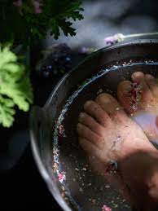
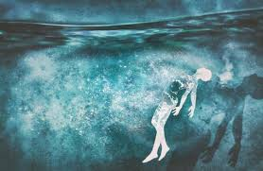
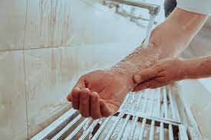
BODY there are two ways to get clean: full body or face and hand washing. Be aware of every step, every wrinkle, every pore of the skin, cleanse while pampering and appreciating every part of your being. A clean heart in harmony with the wateruse to define and
*TIME
Take the time to be aware of the only body you have. Contemplate drop by drop what you are made of
*Art.
Artistically, the image of the body with water has been an indispensable resource. Our body is both a content and a container of universal artistic expression.In him all the elements of nature are materialized

Slide 6
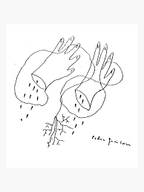
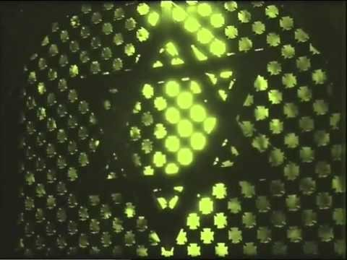
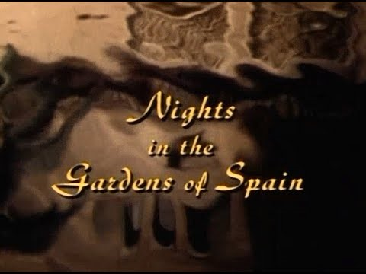
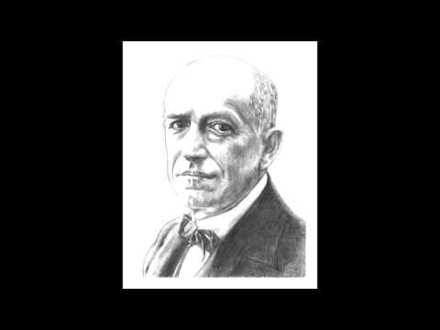
References artists FEDERICO GARCÍA LORCA Federico García Lorca (Fuente Vaqueros, Granada, 5 June 1898 - Camino de Víznar a Alfacar, Granada, 18 August 1936) was a Spanish poet, playwright and prose writer. Ascribed to the generation of '27, he was the most influential and popular poet of twentieth-century Spanish literature and as a playwright he is considered one of the pinnacles of twentieth-century Spanish theater. He was assassinated by the rebel side a month after the coup d'état that provoked the beginning of the Spanish civil war. VAL DEL OMAR (October 27, 1904 in Granada – August 4, 1982 in Madrid) was a Spanish photographer, film director and inventor MANUEL DE FALLA Sound Cartography is the term we use to define and
Aguaespejo granadino is an "audiovisual essay of lyrical plastic” in which he uses techniques of his invention
Water: When it runs, it is a symbol of vitality. When it is stagnant, it represents death. The blood: represents life, therefore, the spilled blood is death. It also symbolizes the fertile, the sexual.
He was a born admirer of Granada and took the city as a muse. Here he found friends and inspiration, writing part of his repertoire in this beautiful city and dyeing classical music with subtle flamenco tints that gave him an unmistakable musical style.One of his compositions that is inspired, even nine years before his first visit to the city, is “La vida Breve”, whose plot takes place in the Albaicin.

Slide 7
what do we have to do?
art has the ability to change the world. Listening and observing the different artistic references and mixing them with our own creativity and ingenuity
exchange of ideas with my group
inspiration and recording of sound and video on city tours and monumental visits
art direction and recording of small sensory and artistic videos on the school set
editing, editing and exhibition of video art
based on the path of water, its meaning and the concepts of sound and body, we must make a VIDEO ART
(MAX. 2MIN)

Slide 8
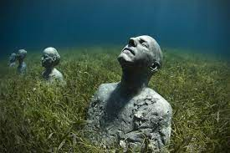
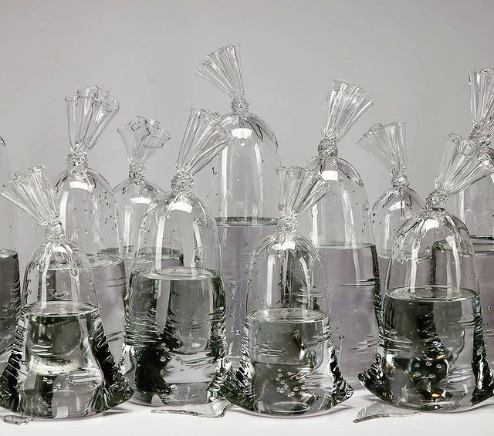
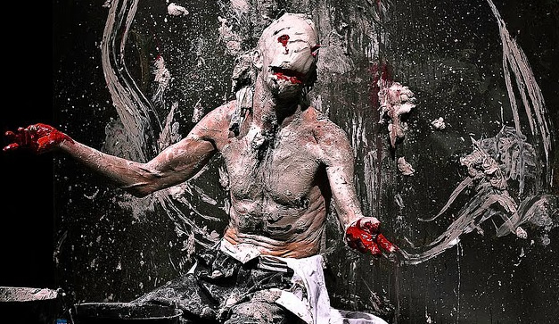
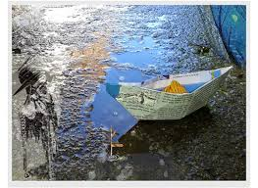
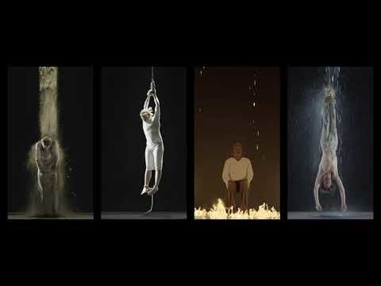
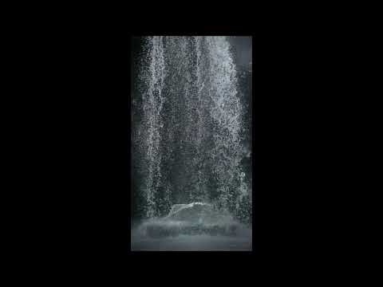
More references
Dylan Martinez

Slide 9




